Slide 1
Postsecondary and Workforce Readiness Act Transitional Math Advising
Samantha Leav, Math Principal Consultant
Illinois State Board of Education

Slide 2
Minimum Criteria for Placement
Notes:
A high school junior who has successfully completed state math graduation requirements but has not met at least two of the college-level math projected readiness criteria will be projected as NOT ready for college-level math and will be given transitional math opportunities in relation to their current math achievement and career interests.
The Transitional Math to STEM pathway has an additional requirement – Students must meet at least one of the following criteria:
B or better in Algebra 1 or a higher math course
Math GPA of 2.5 or higher
Or teacher verification of transitional college algebra prerequisite competencies.
A student should consult with a teacher and/or advisor to determine the appropriate transitional math pathway.

Slide 3
Rethinking Senior Year
Algebra varies with pathway
Contextualization throughout
Default is Quantitative Literacy and Statistics Pathway
For further information on the pathways, please watch the webinar entitled “Transitional Math Pathways and Course Information.”
Notes:
The Postsecondary and Workforce Readiness Act organizes the State’s approach to transitional math into three overarching math pathways; STEM, Quantitative Literacy and Statistics, and Technical.
By school year 2021-2022, school districts will be implementing at least one pathway. School districts should select the pathway that best suits their students needs.
Students that have successfully completed Transition to STEM may be placed into College Algebra, General Education Math, or a Credit-bearing Technical Math course at the community college.
Students that have successfully completed Transition to Quantitative Literacy and Statistics may be placed into General Education Math, or a Credit-bearing Technical Math course at the community college.
Students that have successfully completed Transition to Technical Math may be placed into a Credit-bearing Technical Math course at the community college.
For further information on the pathways, please watch the webinar entitled “Transitional Math Pathways and Course Information.”

Slide 4
Transitional Math and Placement
Algebra 2 is not a pre-requisite.
Transitional Math was designed for seniors that have been identified as not college-ready.
Seniors that are deemed college-ready may take transitional math.
It is suggested that these students take a non-transitional math course.
If the student is debating on taking transitional math or no math class their senior year, it is suggested to allow them to take transitional math.
Notes:
Algebra 2 is not a pre-requisite for Transitional Math.
Transitional Math was designed for seniors that have been identified as not college-ready.
Seniors that have been deemed college-ready may take transitional math but it is suggested that these students take a non-traditional math course such as AP Calc, or Dual Credit. If the student is debating on taking transitional math or no math class their senior year, it is suggested to allow them to take Transitional Math.

Slide 5
Course Completion
Seniors that have successfully completed an approved transitional math course (earning a C or better) will receive automatic placement to a college credit mathematics course at any Illinois community college and accepting universities within 18 months of completing the course.
Seniors that have unsuccessfully completed transitional math (earning below a C) may be subject to taking a math placement test.
For additional information on course approval, please watch the webinar entitled “Transitional Math Portability Process and Documents.”
Notes:
For additional information on course approval, please watch the webinar entitled “Transitional Math Portability Process and Documents.”

Slide 6
Junior Year Advising
A high school junior who has successfully completed state math graduation requirements and meets at least two of the following criteria is projected to be ready for college level coursework in mathematics when arriving at a postsecondary institution in Illinois. This determination is conditional based on enrollment in a senior year of math.
B or better in Algebra 2
C or better in a course higher than Algebra 2
GPA ≥ 3.0
Standardized Assessment: Math SAT or PSAT ≥530 or Math ACT ≥ 22
Placement test score (such as ALEKS, Accuplacer, Compass, local placement instrument, etc.) into college-level math at the partner community college after taking their placement exam
PARCC math score of 4 or 5
Teacher and/or advisor recommendation of college- level math in the senior year.
Notes:
Transitional Math is for students that are not deemed college and career ready. This determination will be made during the junior year with the advisor or mathematics instructor.
**Read slide**

Slide 7
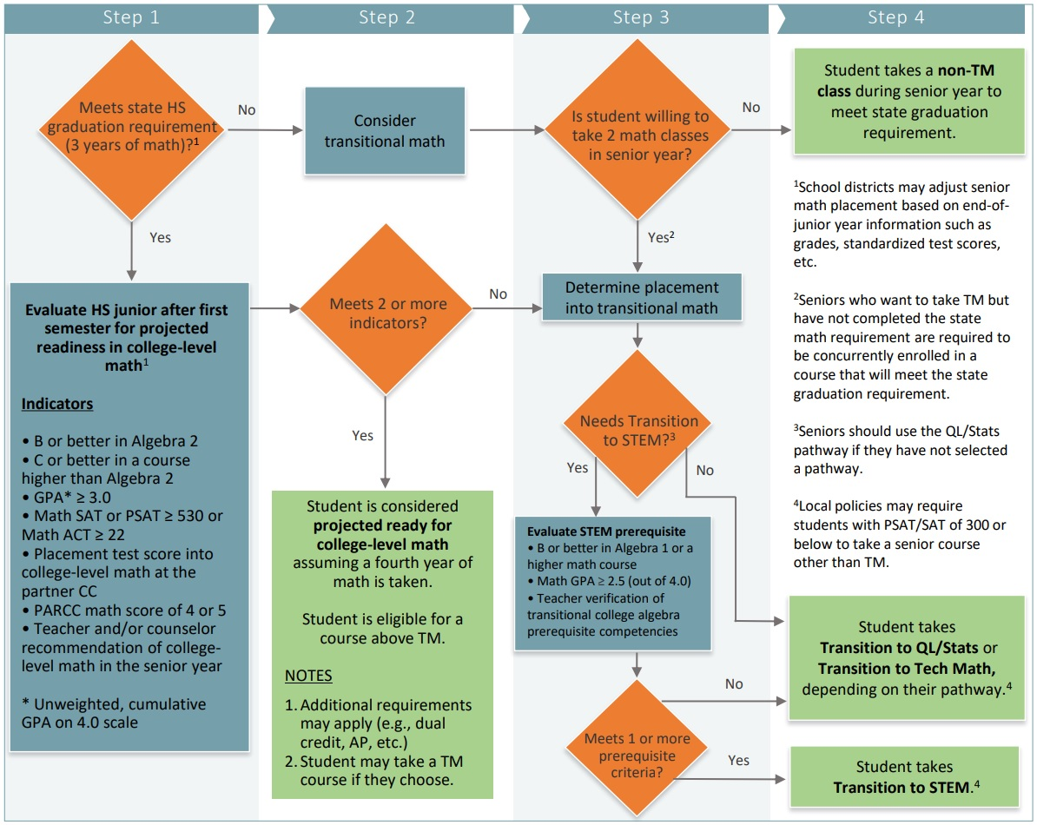
Junior Year Advising Decision Chart
Notes:
In order to assist students in deciding if Transitional Math course is suitable for them, it is suggested to create and use a decision chart. Provided is an example of one created and located on the statewide transitional course website.

Slide 8
If you have questions, or need further assistance, please reach out to TRInstruction@isbe.net.

