Slide 1
Postsecondary and Workforce Readiness Act
Transitional Math
Local Advisory Panel
Samantha Leav
Math Principal Consultant
Illinois State Board of Education

Slide 2
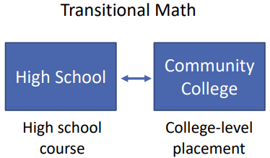
What is the Local Advisory Panel?
The Local Advisory Panel (LAP) is an equal partnership between a community college and partnering school districts.
Statewide Portability Panel (SPP) recommends as a best practice to create a LAP.
Notes:
It is highly recommend that a Local Advisory Panel or LAP should be established and consist of representatives from the community college and partnering school districts.
The LAP is an equal partnership between the community college and patterning school district.

Slide 3
Who is on the Local Advisory Panel?
Members of the Local Advisory Panel should consist of representatives from each high school district and community college. There should be at least one teacher and administrator from the high school district and community college level.
Notes:
Who should be part of the Local Advisory Panel?
Members of the LAP should consist of representatives from each high school district and community college. There should be at least one teacher, administrator, and counselor from the school district and community college.
It is optional to involve universities to participate in the LAP.
Keep in mind that ALL community colleges are required to take part in Transitional Math but not all universities do.

Slide 4
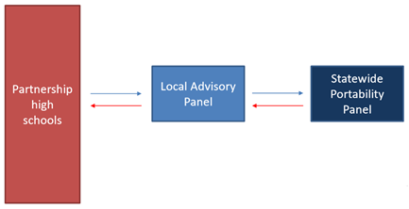
Local Advisory Panel
A Local Advisory Panel should be established and consist of representatives of the partnering high school districts and community college.
The LAP will review portability documents and choose a representative course for each pathway
The community college will submit the documents through the iplacement.org (IAI) system established for transitional math to the Statewide Portability Panel (SPP) for review.​
For additional information on the Portability, please watch the webinar entitled "Transitional Math Portability Process and Documents."
Notes:
The LAP will review portability documents and choose a representative of the courses for each pathway. This means that the LAP will not submit to the Statewide Portability Panel every Transitional Math course for approval. The LAP will select and submit a singular course that represents all of the partnering high school districts Transitional Math courses.
The community college representative will submit the representative's course documents through iplacement.org, which is very similar to the Illinois Articulation Initiative or IAI process, to the Statewide Portability Panel for review.
For additional information on the Portability, please watch the webinar entitled "Transitional Math Portability Process and Documents."

Slide 5
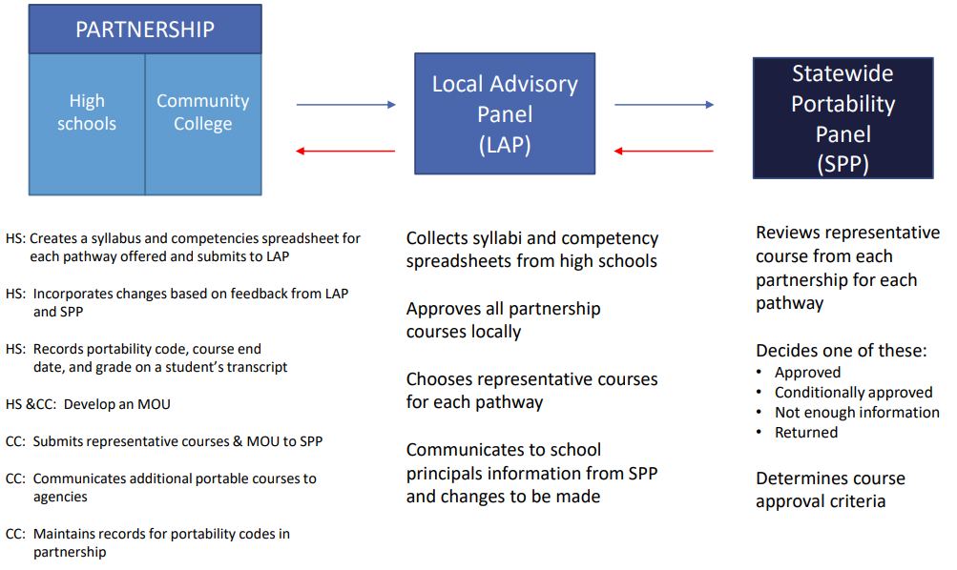
What does the Local Advisory Panel Do?
For additional information on the Portability, please watch the webinar entitled "Transitional Math Portability Process and Documents."
Notes:
LAP should be established.
As a partnership, the school district and community college representatives should create the Memorandum of Understanding.
School districts will use the MOU to create and plan their Transitional Math Course for implementation.
School districts will create and complete syllabus and competencies spreadsheet for each pathway offered and submit to the LAP.
LAP will collect syllabi and competency spreadsheets from school districts.
LAP will approve all partnering school district courses. LAP will provide feedback if necessary.
LAP will select a representative course to submit to the Statewide Portability Panel for approval.
SPP will determine course approval during Statewide Portability Panel Meeting (Fall or Spring of each school year).
LAP will maintain records for portability codes in partnership and communicate additional portable courses to the SPP.
Once approved by the SPP, partnering school districts can now place portability code on student transcripts.
For additional information on the Portability, please watch the webinar entitled "Transitional Math Portability Process and Documents."

Slide 6
If you have questions, or need further assistance, please reach out to TRInstruction@isbe.net.

