Slide 1
Postsecondary and Workforce Readiness Act
Transitional Math Overview
Samantha Leav
Math Principal Consultant
Illinois State Board of Education

Slide 2
What is Postsecondary and Workforce Readiness Act?
On 7/29/16, the Governor signed Public Act 99-0674 (HB 5729).
Four Main Components:
Postsecondary and career expectations (PaCE Framework)
Pilot of competency—based education
College and Career Ready Endorsements
Transitional Courses
  Transitional Math
  Transitional English
Notes:
In July of 2016, the governor signed the Postsecondary and Workforce Readiness Act also known as the PWR Act.
The PWR act has 4 main components:
PaCE – The Postsecondary and Career Expectations framework guides communities on how to organize career exploration and development, college preparation and selection, & financial literacy requirements. The framework presents an understandable format of grade-level activities that can be shared with parents, teachers, and employers.
Pilot of Competency-Based High School Graduation Requirements – In contrast to an education model focused on “seat time” (The amount of time a child spends in a class), A Competency Based education (CBE) model allows students more flexibility to progress as they demonstrate mastery of concepts. The PWR Act establishes a pilot program for voluntary school district participation in moving from “seat time” graduation requirements to competency-based high school graduation requirements. The Act includes a streamlined waiver process for pilot districts of laws and regulations that may restrict the competency based system’s implementation. Illinois currently has 45 school districts participating in the pilot, spanning the rural to urban continuum and including several regional collaborations.
College and Career Pathway Endorsements on High School Diplomas – The PWR Act establishes a new system for school districts to award College and Career Pathway. Endorsements on high school diplomas, which validate the hard work of students preparing for life after high school. Endorsements reflect that a student has completed an individualized learning plan, engaged in a career-focused instructional sequence, participated in work-based learning, and demonstrating readiness for college-level reading and math. Public-Private committees have developed technical and employability competencies aligned to employer expectations that will be incorporated into Endorsement programs. More than 100 high schools are piloting the Endorsements in the 19-20 school year, with continued scaling in future years.
Transitional Course Instruction to Avoid Remediation – The PWR Act establishes a new statewide system for transitional course instruction that increases college readiness for high school seniors and reduces remedial education needs. Transitional Math is currently in the implementation phase and Transitional English is in the planning phase. All Illinois community colleges and hundreds of high schools are currently implementing transitional math, moving toward full statewide implementation by 2021-2022. Successful completion of transitional math instruction provides students with guaranteed placement into college-level math courses at all Illinois Community colleges and accepting Illinois universities. Transitional math instruction emphasizes authentic learning experiences aligned with careers as well as a student’s life and future coursework.

Slide 3
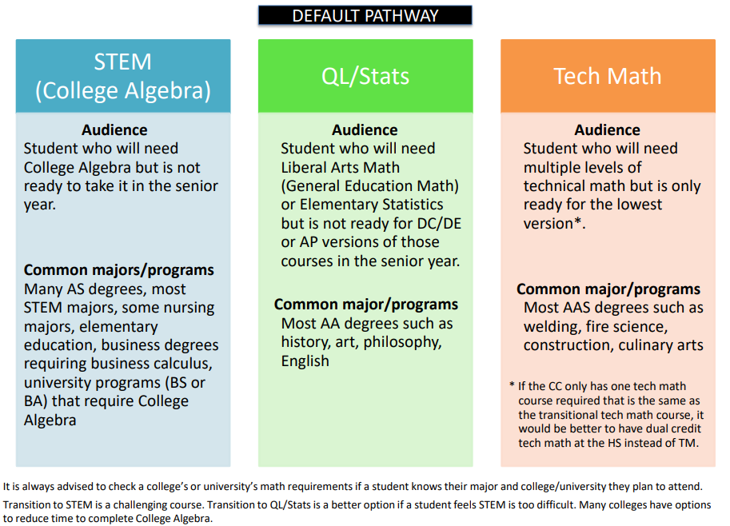
Transitional Math Pathways
For further information on the pathways, please watch the webinar entitled “Transitional Math Pathways and Course Information.”
Notes:
There are three different possible pathways for Transitional Math with the student’s career goals in mind. School districts must implement at least one pathway.
Transitional to STEM is designed for students whose career goals are in the Science, Technology, Engineering, or Mathematics fields. These students require advanced algebraic skills or are calculus bound. Students will focus on a traditional math pathway to gain skills needed to succeed in algebra-heavy coursework. This pathway may also include business majors.
Transition to Quantitative Literacy and Statistics is designed for students that will focus on statistics, data analysis, problem solving, and quantitative literacy. Students will understand the meaning behind the math and be able to explain it.
Transition to Technical math is for students whose career goals are in the technical fields. These students do not require calculus, advanced algebra, or advanced statistics. Students will see the application to their specific career goals.
For further information on the pathways, please watch the webinar entitled “Transitional Math Pathways and Course Information.”

Slide 4
Transitional Math Instructional Mind Shift
Transitional math courses work to address the gaps in understanding emphasizing conceptual understanding and modeling through problem-based learning and projects, mathematical discourse, and integration of concepts, not solely skill acquisition.
The study of algebra is included in all three pathways; however, its emphasis varies depending on the outcome pathway. Instruction should be contextualized and emphasize authentic applications whenever possible, and instructional strategies integrating mathematics competencies with other academic and career competencies are encouraged for all students.
The appropriate use of technology is strongly encouraged.
Notes:
Many students entering into remedial math courses have struggled with math their entire lives, so requiring just “another math course” was not a great message to send. Transitional math courses aligned to the pathways indicated in the PWR Act call for math applicability and contextualization aligned to a student’s career pathway.

Slide 5
Why Transitional Math?
Transitional Math (TM) has tremendous potential to…
Reduce remediation rates
On average, 50% of IL HS graduates are placed into remedial education.
Help students complete a degree or certificate
Fewer than 40% of CC students complete any type of degree or certificate within six years (Source: Bailey, 2015). Remediation plays a role.
Have higher earning potential and possibly a better quality of life
Individuals without a degree or certificate have dramatically reduced earning protentional (Source: Belfield and Bailey, 2017).
By 2020, 65% of all jobs in the economy will require postsecondary education and training beyond high school.
*Recovery: Job Growth and Education Requirements, Georgetown University
Notes:
On average, 50% of Illinois high school graduates enrolling as full-time freshmen in Illinois community colleges require remedial education. Meaning, they do not meet the requirements to place into a 100-level (or higher) course and need to take developmental courses to gain the skills needed for transfer-level courses.

Slide 6
Key Points
Beyond the whys, there are many other key facets.
Who: seniors who have met the state graduation requirement
When: placement granted for 18 months after successful completion; transcribed at High School level
Where: at High School from High School teachers; dual credit qualifications do not apply; flexibility provided
Notes:
Beyond the whys, there are many other key facets.
Transitional math is for high school seniors who have met the state mathematics graduation requirement.
Upon successful completion of an approved transitional math course, students will receive automatic placement into a college bearing course. This will be transcribed by the high school.
Students will complete this course at the high school with high school teachers. There is flexibility provided for high school teachers and dual credit qualifications do not apply.

Slide 7
Illinois Goal: 60 by 25
Goal
60% of all adults have a college or career credential by 2025
Illinois students should be graduating high school ready with the knowledge and skills necessary to be successful in life after high school – college and career.
8 out of 10 Illinois employers say they need employees with some postsecondary education (Source: 60by25.org).
Currently only 40% of Illinois residents have a high-quality post-secondary college or career credential.
Source:60by25.org

Slide 8
Transitional Math
Goal
Reduce Remediation
Determine who is not college-ready for math in the junior year.
Remediate with new transitional courses in the senior year.
Provide guaranteed placement into college credit math courses to all Illinois community colleges and some participating universities.
Result
Students start at college-level coursework, increasing their chances of completing a certificate or degree.

Slide 9
Benefits
Transitional Math benefits students:
Reduces barriers that prevent degree completion
Saves time and money (economical)
Allows students deemed “not ready” for college level coursework to strengthen skills during the senior year through contextualized, authentic, and performance-based application

Slide 10
Additional Benefits
Better serve underrepresented groups and increase equity and access
Improve a school’s Every Student Succeeds Act (ESSA) score in the College and Career Readiness (CCR) category
Reduce number of students in developmental education
Increase number of students in college math
Increase completion rates
Improve relationships and alignment between K-12 and colleges

Slide 11
If you have questions, or need further assistance, please reach out to TRInstruction@isbe.net.

