Slide 1
Postsecondary and Workforce Readiness Act
Transitional Math
Pathways and Course Information
Samantha Leav, Math Principal Consultant
Illinois State Board of Education

Slide 2
Transitional Math Pathways
The Postsecondary and Workforce Readiness Act organizes the State’s approach to transitional math into three overarching math pathways.
STEM Pathway
Quantitative Literacy and Statistics Pathway
Technical Math Pathway
Notes:
The Postsecondary and Workforce Readiness Act organizes the State’s approach to transitional math into three overarching math pathways; STEM, Quantitative Literacy and Statistics, and Technical. School districts must implement at least one pathway that will meet students needs.

Slide 3
STEM Pathway
The STEM Pathway is for students with career goals involving occupations that require the application of calculus or advanced algebraic skills.
Notes:
Transitional to STEM is designed for students whose career goals are in the Science, Technology, Engineering, or Mathematica fields. These students require advanced algebraic skills or are calculus bound. Students will focus on a traditional math pathway to gain skills needed to succeed in algebra-heavy coursework. This pathway may also include business majors.

Slide 4
Quantitative Literacy and Statistics Pathway
The Quantitative Literacy and Statistics Pathway is for students focused on attaining competency in general statistics, data analysis, quantitative literacy and problem solving.
This pathway is intended for students whose career goals do not involve occupations relating to either the STEM or Technical Math Pathway or those who have not yet selected a career goal.
Notes:
Transition to Quantitative Literacy and Statistics is designed for students that will focus on statistics, data analysis, problem solving, and quantitative literacy. Students will understand the meaning behind the math and be able to explain it.

Slide 5
Technical Math Pathway
The Technical Math Pathway is for students with career goals involving occupations in technical fields that do not require the application of calculus, advanced algebraic, or advanced statistical skills.
The mathematics in this pathway emphasizes the application of mathematics within career settings.
Notes:
Transition to Technical is for students whose career goals are in the technical fields. These students do not require calculus, advanced algebra, or advanced statistics. Students will see the application to their specific career goals.

Slide 6
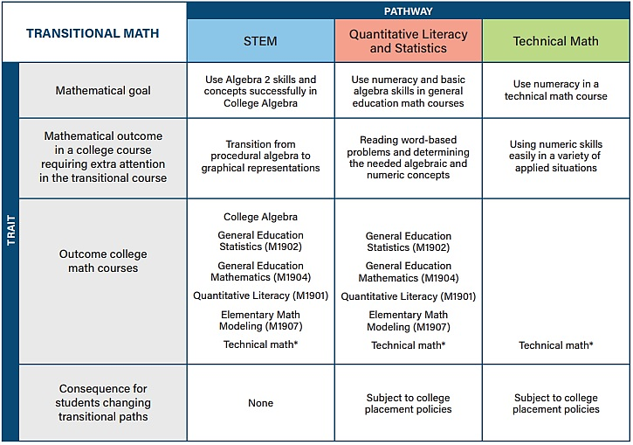
Differences in Pathways
Notes:
Students that have successfully completed Transition to STEM may be placed into College Algebra, General Education Math, or a Credit-bearing Technical Math course at the community college.
Students that have successfully completed Transition to Quantitative Literacy and Statistics may be placed into General Education Math, or a Credit-bearing Technical Math course at the community college.
Students that have successfully completed Transition to Technical Math may be placed into a Credit-bearing Technical Math course at the community college.

Slide 7
Instructional Approach
Transitional math courses should enable students to develop conceptual understanding and problem solving competencies while increasing college readiness in the path of their choice. The courses emphasize conceptual understanding and modeling rather than procedures and symbolic manipulation.
The study of algebra is included in all three pathways; however, its emphasis varies depending on the outcome pathway.
Notes:
Many students entering into remedial math courses have struggled with math their entire lives, so requiring just “another math course” was not a great message to send. Transitional math courses aligned to the pathways indicated in the PWR Act call for math applicability and contextualization aligned to a student’s career pathway.

Slide 8
Course Information
The title of the course, duration, and courses for automatic placement depends on decisions made during the formation of the MOU with the local community college.
Some community colleges have requested the titles all be the same and have indicated what the course title will be. Other community colleges have decided that the school districts will decide on the course title.
For further information on the Local Advisory Panel, please watch the webinar entitled “Transitional Math Local Advisory Panel.”
Notes:
School districts and community colleges will work together as a partnership to determine the title of the course, duration of the course, and what community college courses students will be placed upon successful completion of the high schools transitional course, etc.
For further information on the Local Advisory Panel, please watch the webinar entitled “Transitional Math Local Advisory Panel.”

Slide 9
If you have questions, or need further assistance, please reach out to TRInstruction@isbe.net.

