Slide 1
Postsecondary and Workforce Readiness Act Transitional Math Portability Documents
Samantha Leav
Math Principal Consultant
Illinois State Board of Education

Slide 2
What is portability?
Portability provides a system for ensuring the competencies and policies are met. Courses with portability offer a student guaranteed placement at their district community college as well as any other Illinois community college and any accepting Illinois university.
Notes:
So what exactly is portability?
Portability provides a system for ensuring the competencies and policies are being met. Courses with portability offer a student guaranteed placement at their district community college as well as any other Illinois community college and any accepting Illinois University.

Slide 3
Portability
Guaranteed placement will follow students that have successfully completed Transitional Math courses with a ‘C’ or higher.
Courses may be approved by the Statewide Portability Panels during the fall or spring of the school year.
Notes:
Upon completion with a "C" or higher in Transitional Math students will earn guaranteed placement into a credit bearing mathematics course at the community college. This means that students do not have to take a placement test.
In order for students to receive guaranteed placement, the Transitional Math course must be approved by the Statewide Portability Panel. This can be done in the Fall or Spring of the school year.

Slide 4
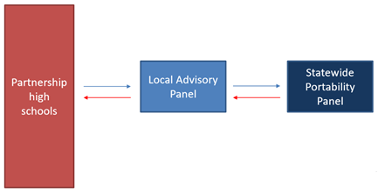
Local Advisory Panel
A Local Advisory Panel should be established and consist of representatives of the partnering high school districts and community college.
The LAP will review portability documents and choose a representative course for each pathway
The community college will submit the documents through the iplacement.org (IAI) system established for transitional math to the Statewide Portability Panel (SPP) for review.​
For additional information on the Portability, please watch the webinar entitled "Transitional Math Portability Process and Documents."
Notes:
The LAP will review portability documents and choose a representative of the courses for each pathway. This means that the LAP will not submit to the Statewide Portability Panel every Transitional Math course for approval. The LAP will select and submit a singular course that represents all of the partnering high school districts Transitional Math courses.
The community college representative will submit the representative's course documents through iplacement.org, which is very similar to the Illinois Articulation Initiative or IAI process, to the Statewide Portability Panel for review.
For additional information on the Portability, please watch the webinar entitled "Transitional Math Portability Process and Documents."

Slide 5
Portability Documents
Three documents need to be submitted for portability:
Memorandum of Understanding (MOU)
Representative Course Syllabus
Representative Course Competency Spread Sheet
Notes:
There are three documents that will be submitted to the Statewide Portability Panel.
1. Memorandum of Understanding also called MOU.
2. A representative course syllabus
3. A representative course competency spread sheet.
If you are looking for samples or templates, they can be found on the Illinois Transitional Math website.
Documents should all be from one representative course. Please do not submit a course syllabus from one representative course and a course competency spread sheet from a different representative course.
I will be explaining representative courses later in the webinar.

Slide 6
Portability Documents Memorandum of Understanding (MOU)
An agreement developed collaboratively between the community college and high schools that defines components of the Transitional Math courses.
The broad requirements within the MOU must be consistent across all high schools in the partnership.
Within the MOU, grading requirements must meet the following:
At least 25% of the overall grade must come from problem or project-based learning tasks.
A single assessment may not be more than 50% of the final grade in the course.
No more than 25% of the course can come from formative assessments such as homework.
Notes:
The Memorandum of Understanding or MOU is an agreement developed collaboratively between the community college and high schools that defines components of the Transitional Math courses.
The broad requirements within the MOU must be consistent across all high schools in the partnership.
Some specific topics that should be discussed are:
Course Title
Course Length
Grading Scale – Defining what a "C" is
Test Retakes
Materials
Within the MOU, grading requirements must meet the following:
At least 25% of the overall grade must come from problem or project-based learning tasks.
A single assessment may not be more than 50% of the final grade in the course.
No more than 25% of the course can come from formative assessments such as homework.
Note: In the case of disagreement between policies, statewide grading policies trump local grading policies as required by districts and/or school boards.

Slide 7
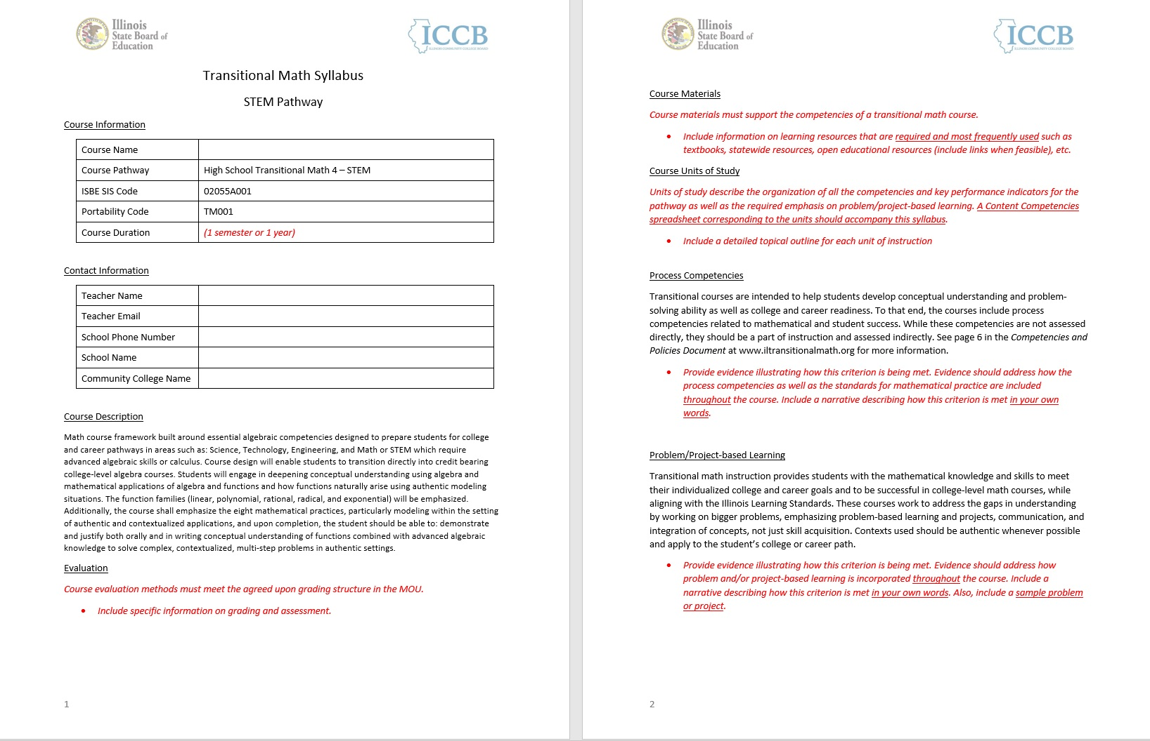
Portability Documents
Syllabus
Notes:
Course syllabus should include course information title, pathway, sis and portability code, description, length, evaluation, course materials, course units of study, process competencies, and problem/project-based learning.
Contact information for the instructor should consist of name, e-mail, phone number, school name and community college.
The course evaluations must meet the agreed upon grading structure in the MOU and align with the grading structure in the TM Statewide Course Competencies and Policies Document. Course evaluations must include specific information on grading and assessments.
Include all course materials that support the competencies of the pathway. Include links when possible for resources. (Examples: textbooks, statewide resources, open education resources, etc.)
Under units of study, describe the organization of all the competencies and key performance indicators for the pathway. The content competencies spreadsheet corresponding to the units should accompany this syllabus.
In a narrative, provide evidence illustrating how the process competencies are included throughout the course.
In a narrative, provide evidence showing how problem and/or project based learning is incorporated throughout the course. A sample problem or project should be included.
**Note: Please review documents to make sure all information in the course information and contact information tables are completed before submitting.**

Slide 8
Portability Documents
Competencies Spreadsheet
Notes:
The competencies spreadsheet is the last required document.
The competencies spreadsheet is one file with multiple sheets.
The first sheet is the course information.
The quantitative literacy and statistics competency spreadsheet has one additional line to identify 3 nonlinear functions covered within the course. This is not required in the STEM and Tech pathway.
**Note: Please review documents to make sure all information in the tables are completed before submitting.**

Slide 9
Portability Documents
Competencies Spreadsheet
Notes:
The second sheet within the competencies spread sheet is an example of how to fill out the competencies. This example is a reflection of a task from the Optional State Provided Resources.

Slide 10
Portability Documents
Competencies Spreadsheet
Notes:
The last sheet provides all of the competencies and the key perforamce indcators for each competency within the pathway.
For each key performance indicator the following must be filled out:
Column B - A unit, lesson, section, task, assessment or etc. where the key performance indicator is being met. Please include unit/section number and title.
Column C - What mathematical topics are covered within that unit, lesson, section, task, assessment or etc.
Column D - A yes or no to indicate if the unit, lesson, section, task, assessment, or etc. Is part of the optional state provided resources.
Column E (Summary of unit, lesson, section, task, assessment, or etc.) and Column F (Additional units, lessons, sections, tasks, assessments, or etc.) are optional but will provide the State Portability Panel with additional information to assist in the approval process.
All key performance indicators MUST be completed.

Slide 11
Submitting Portability
Once the documents have been collected and approved by the LAP for each pathway, the community college will submit all documents to https://iplacement.org/
The portability panel meets in the fall and spring of each school year.
Notes:
Once documents have been collected and approved by the LAP, the community college will submit the representative course to the Statewide Portability Panel for approval.
Each school year, the Statewide Portability Panel meet in the Fall and Spring. Please check the statewide transitional math website for meeting dates.

Slide 12
If you have questions, or need further assistance, please reach out to TRInstruction@isbe.net.

